Slide 1
Student Performance Data Analysis

Slide 2
Dataset: Student Performance Factors
Variables:
Hours Studied
Exam Score
Attendance
Motivation Level
Family Income
Parental Education

Slide 3
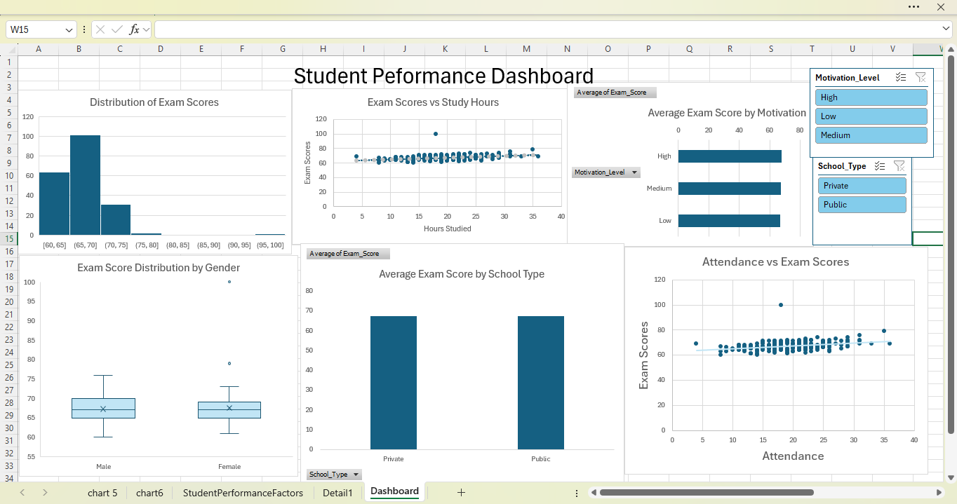
Excel Visualizations
Created a dashboard to get an overall view of student performance
Included exam score distribution, study hours, attendance, and motivation level
Identified trends showing higher study time and attendance lead to better exam scores

Slide 4
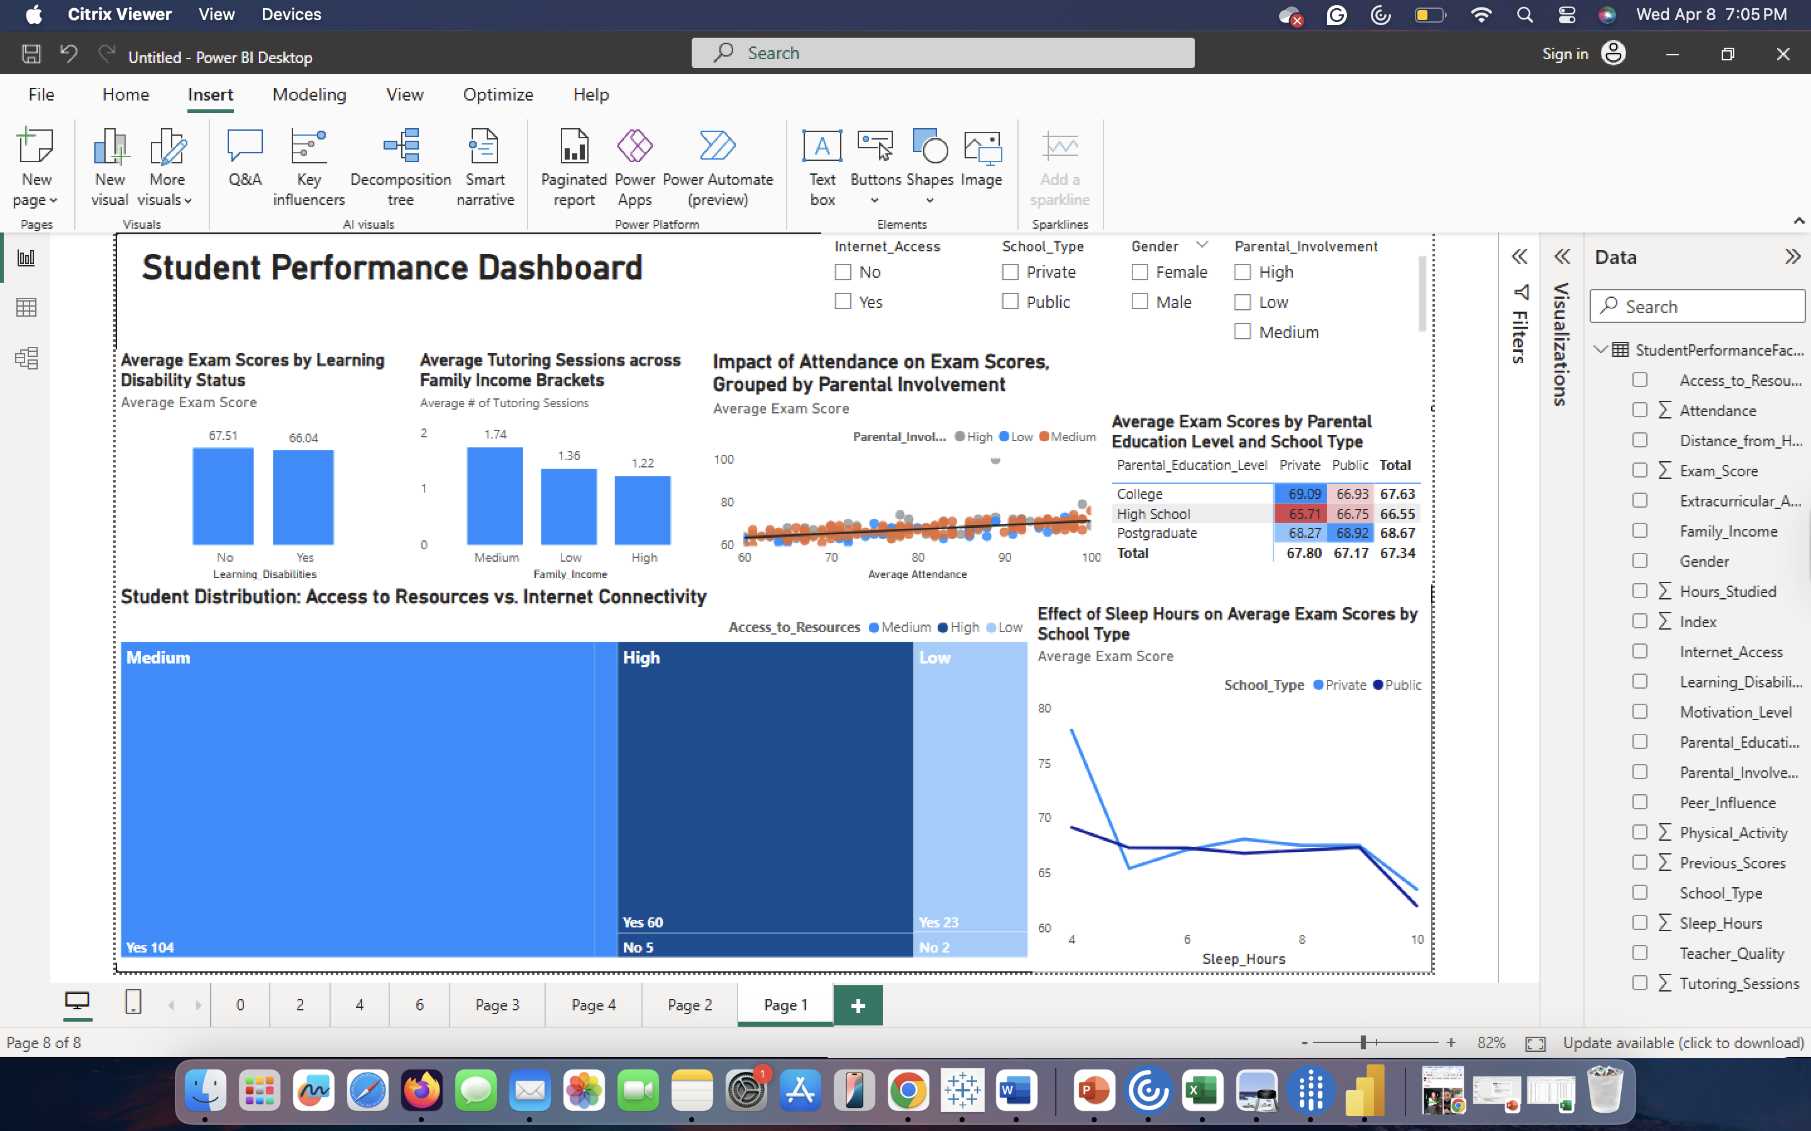
POWER BI VISUALS
Treemap
(Access to Resources vs. Internet): Most students have medium resource access and internet; surprisingly. Important because it proves internet access isn't strictly tied to the lowest resource tiers.
Line Chart (Sleep Hours vs. Exam Score): Performance follows a non-linear trend where scores peak between 6–9 hours of sleep and drop significantly at the 10-hour mark. Measures student well-being; important for identifying an "optimal sleep window".

Slide 5
POWER BI VISUALS
Column Chart (Disability Status):
The achievement gap is minimal (only 1.5 points), indicating that institutional accommodations are effectively leveling the playing field for students with disabilities.
Clustered Column Chart (Tutoring vs. Family Income):
Medium-income students utilize the most tutoring sessions, while high-income students utilize the least, suggesting unique academic investment strategies.
Scatter Plot (Attendance vs. Exam Score):
Higher attendance correlates with better scores, but high parental involvement provides a consistent performance boost regardless of attendance levels.
Matrix (Parent Education vs. School Type):
Parental background is a stronger predictor of success than school type; private schools do not guarantee higher scores for students with less-educated parents.

Slide 6
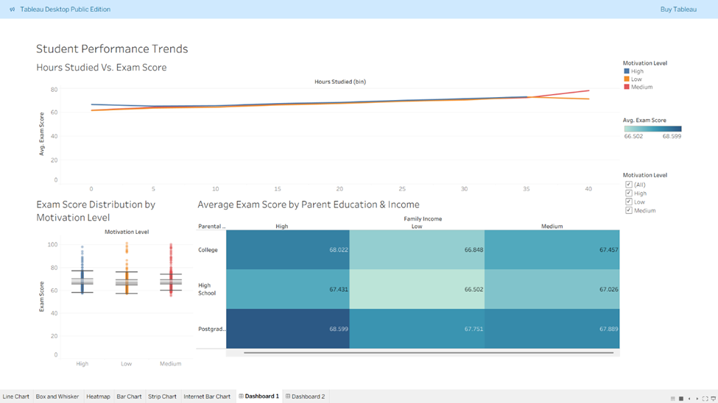
TABLEAU VISUALS
Line chart (Hours Studied vs. Exam Score): More study hours generally lead to higher exam scores, regardless of motivation level
Box plot (Motivation Level): Students with higher motivation tend to score slightly better, but distributions overlap
Heatmap (Parent Education & Income): Higher income and parent education are associated with higher average exam scores

Slide 7
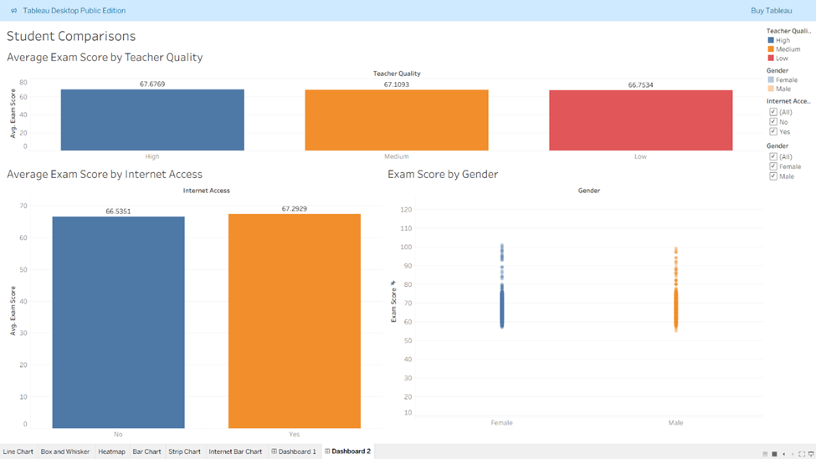
TABLEAU VISUALS
Average Exam Score by Teacher Quality: Scores remain stable across quality levels, with a narrow range between 66.75 and 67.67.
Average Exam Score by Internet Access: Students with internet access average slightly higher (67.29) than those without (66.53).
Exam Score by Gender: Both groups show similar score distributions and density, with individual performance peaking near 100% for both genders.

Slide 8
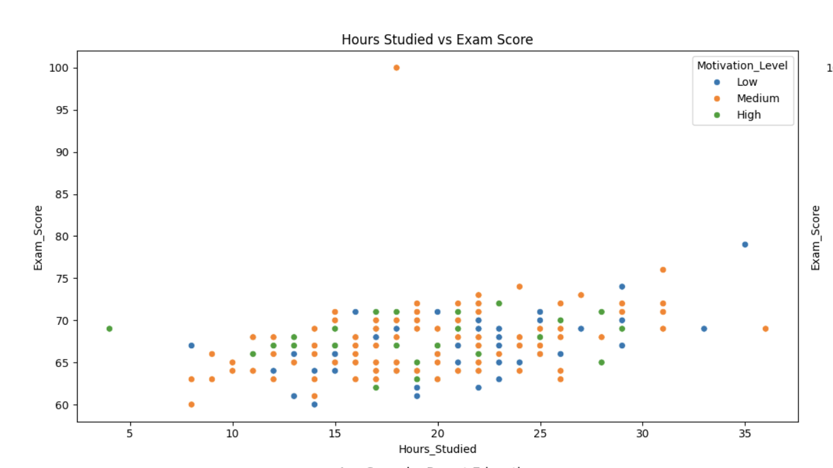
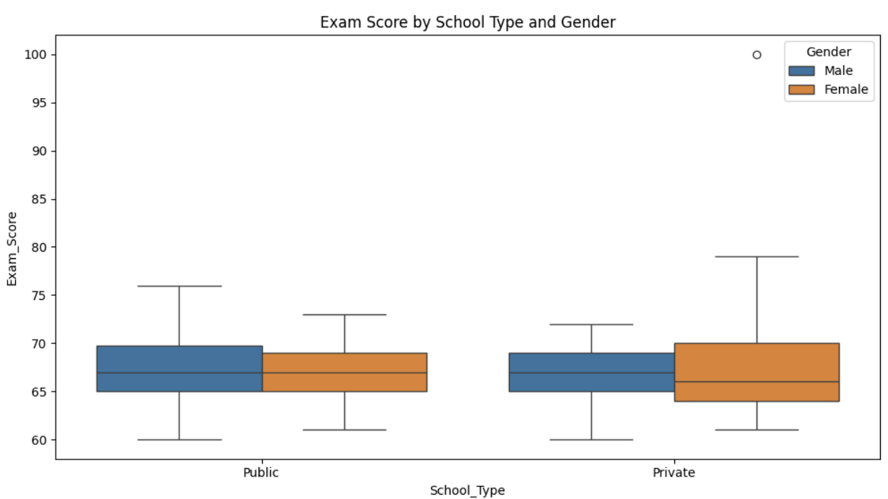
PYTHON VISUALS
Scatter Plot (Hours Studied vs. Exam Score by Motivation):
Analyzes work ethic vs. Output. important for seeing that highly motivated students often achieve higher scores with fewer study hours compared to their low-motivation peers.
Box Plot (School Type vs. Exam Score by Gender):
Identifies distribution and outliers. essential for revealing that while median scores are similar across school types, private schools show higher performance variance and a notable high-scoring male outlier.

Slide 9
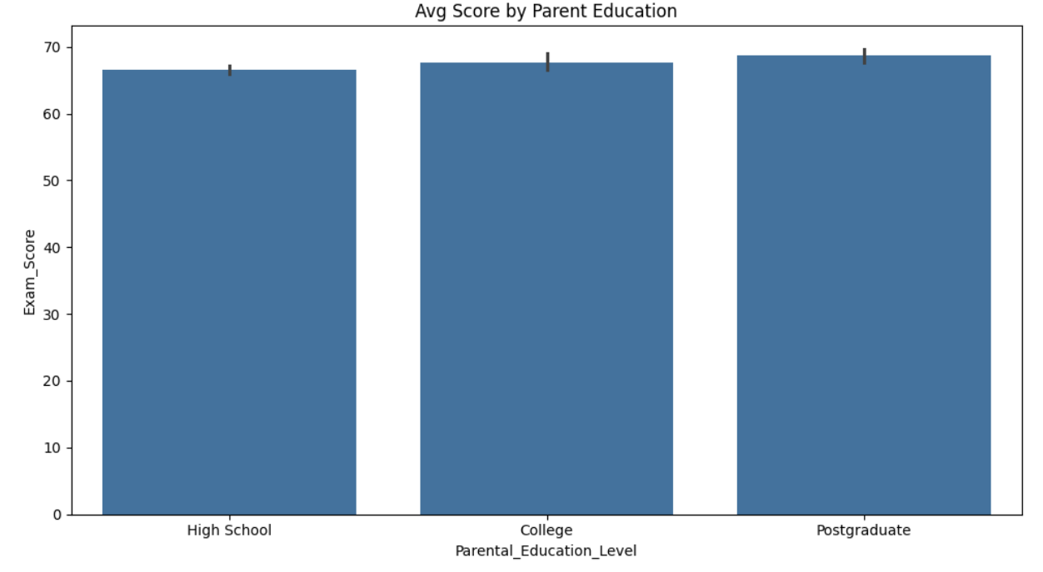
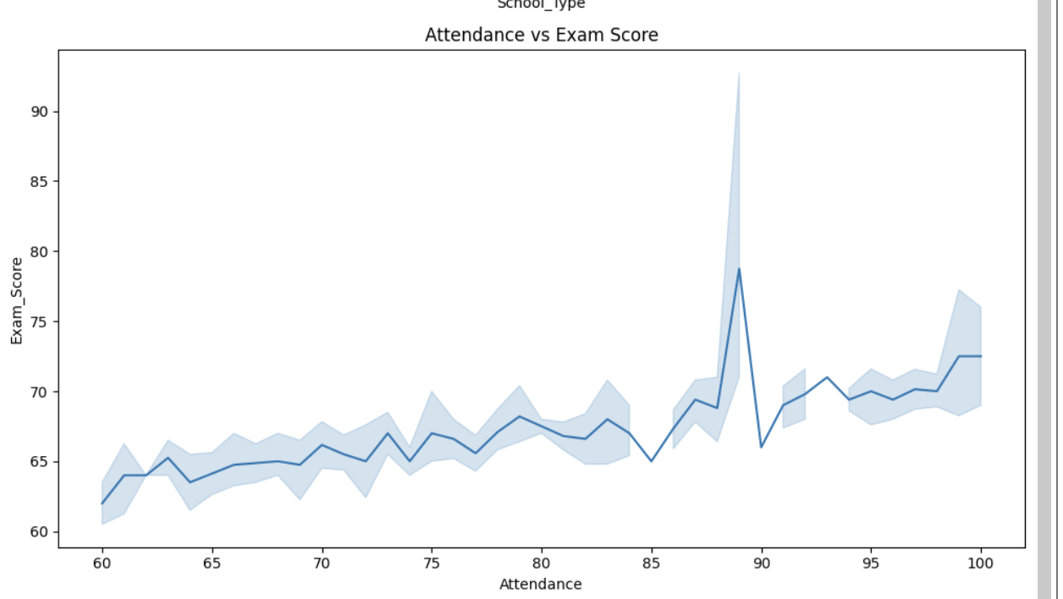
PYTHON VISUALS
Bar Chart (Avg Score by Parent Education):
Evaluates academic legacy. important for demonstrating the clear, stepwise increase in student performance as parental education levels rise from High School to Postgraduate.
Line Chart (Attendance vs. Exam Score):
Tracks the direct impact of presence. vital for identifying the steady academic climb as attendance increases, including a significant performance peak that occurs at the 88/89% attendance mark.

Slide 10
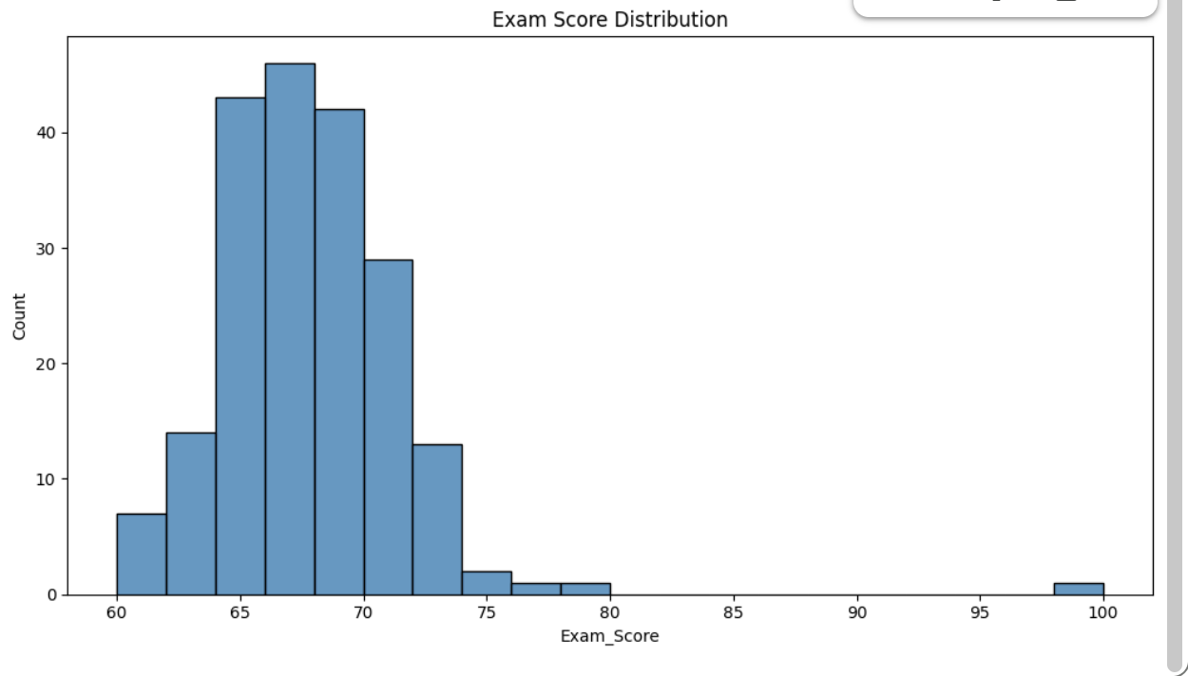
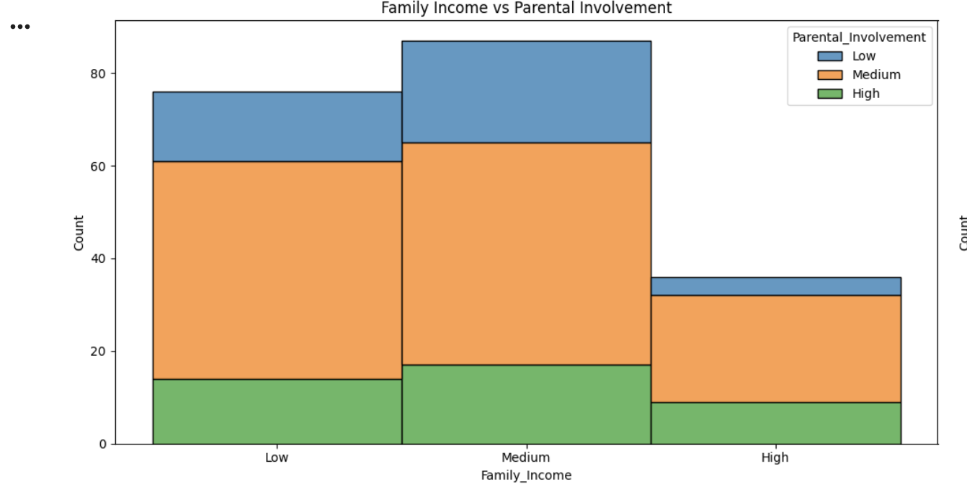
PYTHON VISUALS
Stacked Bar (Family Income vs. Parental Involvement):
Measures socioeconomic overlap. crucial for showing that Medium-income families actually have the highest volume of involvement, rather than the High-income bracket as one might assume.
Histogram (Exam Score Distribution):
Visualizes score frequency; important because it reveals a normal distribution centered around 65–70, which is impossible to aggregate by simply looking at the raw rows in the data set.

Slide 11
KEY FINDINGS
Some of the Key things we found were that:
The dataset had sufficient variables to compare where we could see their impact. For future improvement, other factors like classes taken, amount of homework, travel time to and from school, number of parents in household, number of siblings, and the school district could be added to draw more conclusions and find more dependability.

Slide 12
WHAT WAS LEARNED
Some of the things we learned throughout his project were how the different variables were affecting each other, as well as how some types of charts make information clearer for the audience

